Slide 1




Using OpenCV and Tensor: Gesture Recognition Using American Sign Language
Discover the fascinating world of gesture recognition using the powerful combination of OpenCV and Tensor. we will explore the importance and applications of recognizing American Sign Language (ASL) gestures, and how OpenCV and Tensor can revolutionize communication and inclusion for the deaf community.
by Disha Agrawal

Slide 2
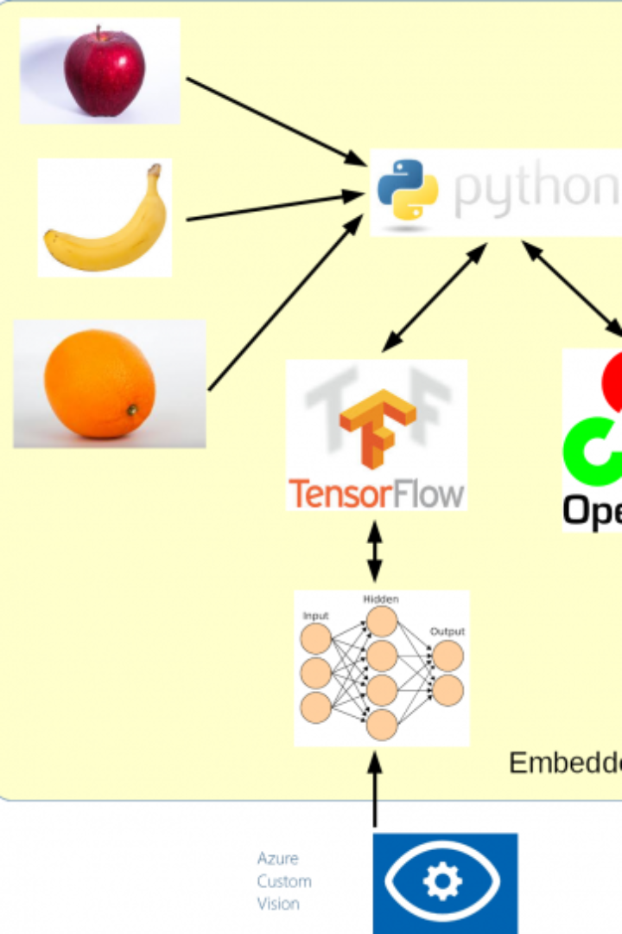
Gestures
"Connecting Humanity to Technology through the Language of Gestures Unraveling the Digits and Alphabets: OpenCV and Tensor Unite for Precision Recognition.". OpenCV and TensorFlow, it not only improves accuracy but also makes this technology accessible, opening doors to innovative applications across various domains, from healthcare and gaming to virtual reality and smart homes.

Slide 3
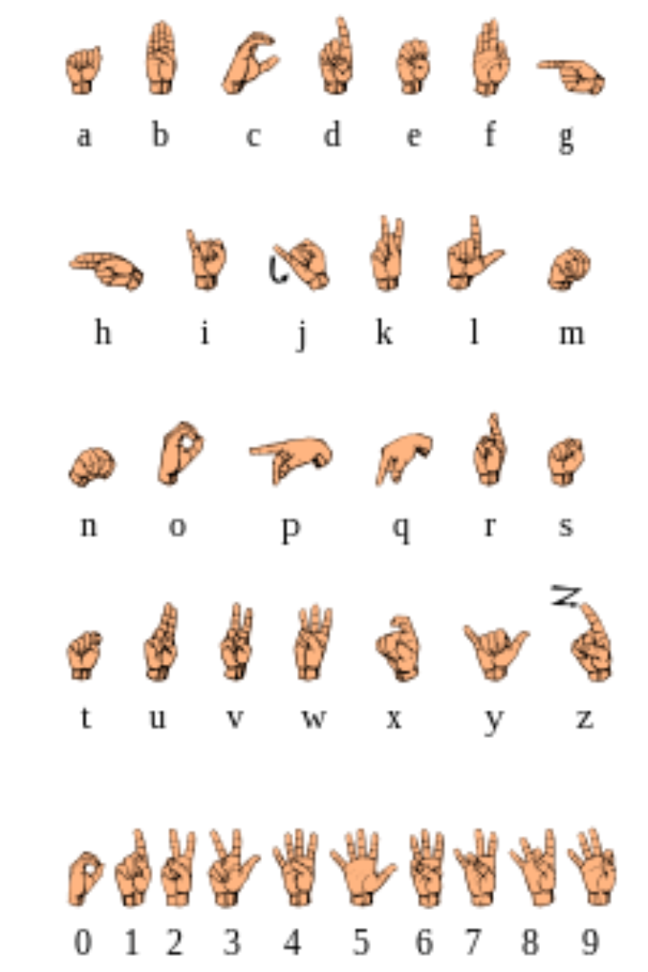
American Sign Language (ASL)
Learn about the rich history and significance of ASL, a visual-gestural language used by the deaf community. Discover how ASL gesture recognition can empower individuals with hearing impairments by facilitating seamless communication and fostering inclusivity in various domains, from education to everyday interactions.

Slide 4
Gesture Recognition Techniques
Gesture recognition involves a variety of techniques and algorithms, some of which are applicable to recognizing ASL gestures. Here are a few key methods:
Computer Vision and Hand Tracking: OpenCV is a versatile computer vision library that can be used to track and detect hands in real-time. The cvzone library, which is based on OpenCV, simplifies hand tracking by providing pre-built modules like HandDetector. This is essential for isolating the hand and extracting features for recognition.
Deep Learning: Deep neural networks, especially convolutional neural networks (CNNs), are commonly used for gesture recognition. TensorFlow, a popular deep learning framework, can be employed to train and deploy models. In the provided code, the Classifier uses a pre-trained model for gesture classification. To recognize ASL gestures effectively, you would need a diverse dataset and an appropriate model architecture.
Feature Extraction: Feature extraction techniques are crucial for gesture recognition. They involve capturing distinctive characteristics of hand and finger movements, which can be fed into a machine learning model. Features can include hand shape, finger positions, and motion trajectories.
Recurrent Neural Networks (RNNs): RNNs can capture the temporal aspects of gestures, which is essential for ASL recognition since ASL involves dynamic hand movements and gestures that evolve over time.
Transfer Learning: Utilizing pre-trained models and fine-tuning them for gesture recognition can save time and computational resources. Transfer learning can be applied to adapt models for recognizing specific gestures like ASL signs.

Slide 5

Training and Testing
Dive into the process of training machine learning models using ASL gesture datasets. Experience the journey of transforming raw data into powerful models that can understand and respond to ASL gestures. Discover how validation and evaluation play a crucial role in ensuring accuracy and reliability, making gesture recognition a seamless experience. We have achieved this google
teachablemachine.withgoogle.com train giving us keras.h5 and labels.txt as a model classifier

Slide 6

Scope:-
Detecting American Sign Language (Alphabets, digits, Gestures)

Slide 7
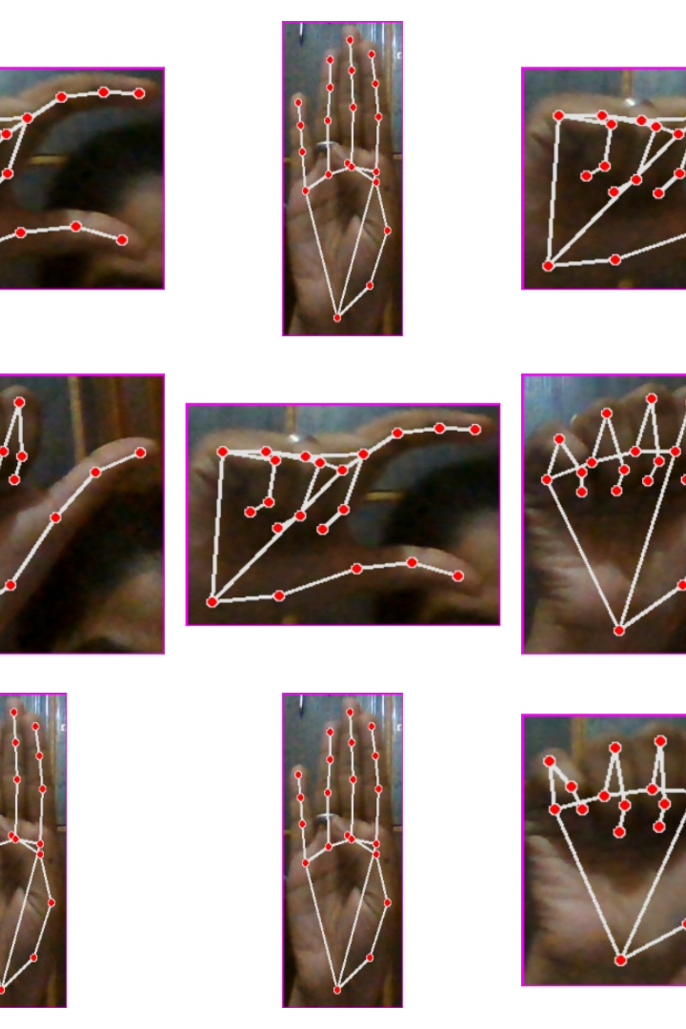
Select Dataset
we are creating our own dataset thus this is a real time detection we can make our model capable of detecting any sign
steps followed are:
open webcam
crop the image
Make new image with same size considering same width and height

Slide 8

Preprocessing Dataset
crop image
Make an empty image now paste crop image over their
Now fix the size of the image
Alter image if height greater than width and vise versa

Slide 9
Model Selection
Since their are so many available model but trying to learn how a model works so steps followed are
Visit teachable.google.com to train our model with our data
The generated model is downloaded
Now the reference of this is given reference in test.py file
The labels are gives in a list and these are compared with those gives by our tens flow keras model

Slide 10
Challenges and Future Directions
Delve into the challenges faced in ASL gesture recognition and explore potential solutions. Discuss the limitations and explore ways to overcome them, paving the way for more advanced and accurate recognition systems. Look into the future of ASL gesture rupecognition, envisioning how emerging technologies can further enhance communication and empower the deaf community.

Slide 11
Conclusion
Summarize the content of this document, emphasizing the significance of ASL gesture recognition in fostering inclusive communication. Reflect on the potential of OpenCV and Tensor in revolutionizing the way we understand and interact with ASL. Leave readers inspired to explore and embrace the power of gesture recognition technology.

